Slide 1

BASIC ELECTRICAL ENGINEERING
D. C. KULSHRESHTHA,
PowerPoint Slides
PROPRIETARY MATERIAL. © 2010 The McGraw-Hill Companies, Inc. All rights reserved. No part of this PowerPoint slide may be displayed, reproduced or distributed in any form or by any means, without the prior written permission of the publisher, or used beyond the limited distribution to teachers and educators permitted by McGraw-Hill for their individual course preparation. If you are a student using this PowerPoint slide, you are using it without permission.
Ch. 1 Introduction

Slide 2

Chapter 1
Introduction
D.C. Kulshreshtha
Ch. 1 Introduction

Slide 3
Topics to be Discussed
Electric Current.
Types of Electric Current.
Defining a Current.
Voltage or Potential.
Energy.
Passive Sign Convention .
Ch. 1 Introduction

Slide 4
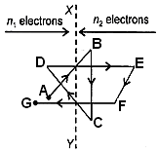
Electric Current
Free electrons in a conductor move in a haphazard, zig-zag, or random way.
Ch. 1 Introduction

Slide 5
There is no flow of electric current due to random motion of electrons.
At any instant, the number n₁ of electrons crossing from left to right is the same as the number n₂ of electrons crossing from right to left.
When a voltage is applied, in addition to the random movement, the electrons drift towards positive terminal.
Ch. 1 Introduction

Slide 6
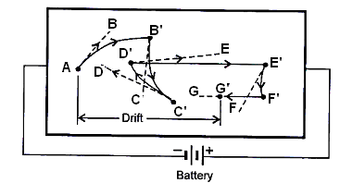
Instead of going straight from A to B, the electron takes a curved path and reaches B’.
This drift of charge carriers (here, electrons) results in an electric current, called drift current.
Ch. 1 Introduction

Slide 7
The average velocity of the charge carriers moving under the influence of an applied electric field is called drift velocity (vd).
It is of the order of mm/s.
Then, how is it that when you switch on a light, it glows almost instantly ?
Ch. 1 Introduction

Slide 8
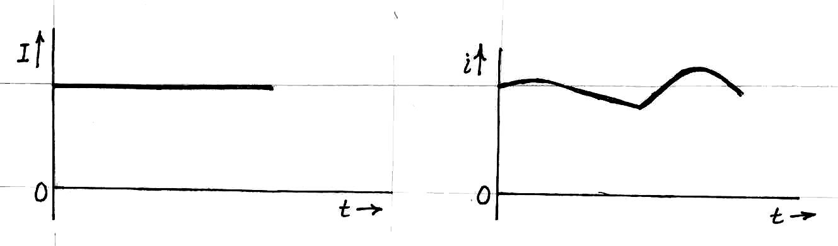
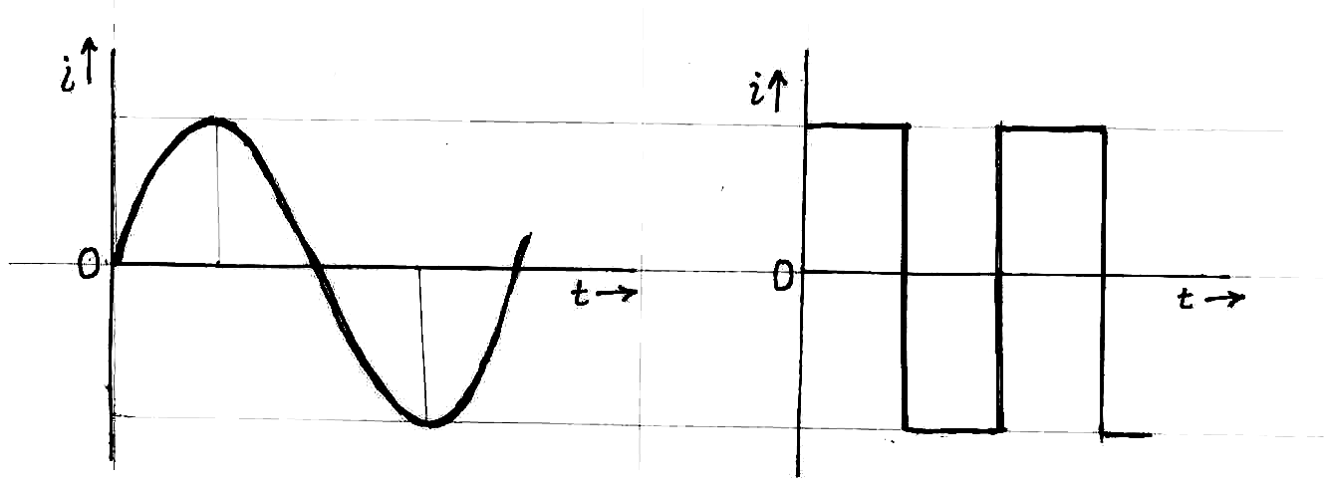
Types of Electric Current
(a) DC current. (b) Pulsating current.
Unidirectional current.
(a) Sinusoidal ac current. (b) Square-wave ac current.
Alternating current.
Ch. 1 Introduction

Slide 9
Note that the abbreviations ‘dc’ for ‘direct current’ and ‘ac’ for ‘alternating current’ have been taken as adjectives.
Hence, it is perfectly alright to say, ‘ac current’ or ‘dc voltage’, etc.
Ch. 1 Introduction

Slide 10
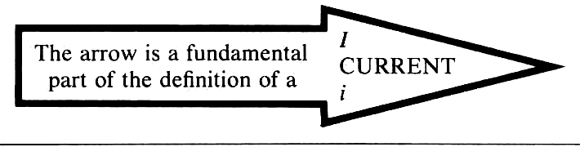
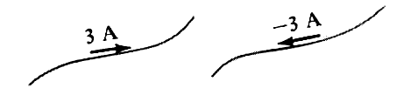
Defining a Current
Two methods of representation for
the same current.
Ch. 1 Introduction

Slide 11
Voltage or Potential
Mostly, we are interested in potential difference (pd) also called voltage, and not in absolute potential.
1 volt (V) = 1 joule / 1 coulomb = 1 J/C.
The notation V_{AB} denotes the voltage of point A with respect to point B.
It is simply the voltage rise from B to A.
It is same thing as the voltage drop from A to B.
Ch. 1 Introduction

Slide 12
What is the voltage V_{AB} in following three cases ?
(a) (b) (c)
Ch. 1 Introduction

Slide 13
What is the voltage V_{AB} in following three cases ?
(a) (b) (c)
Answer:
Voltage V_{AB} = 4 V.
Voltage V_{AB} = - 4 V.
Voltage V_{AB} = -(- 4) V =4 V
Ch. 1 Introduction

Slide 14
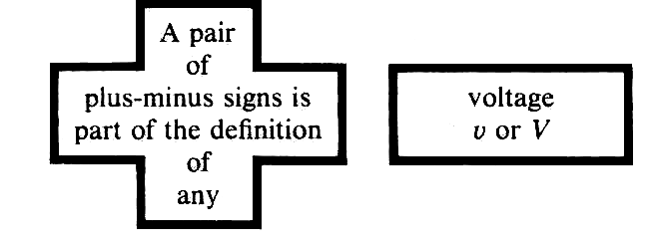
Ch. 1 Introduction

Slide 15
Energy
The element is absorbing energy
(a passive element)
(b) The element is delivering energy.
(an active element)
Ch. 1 Introduction

Slide 16
Passive Sign Convention says that the current must enter the plus-marked terminal of the element.
Unit of energy is joule (J).
Unit of power is watt (W).
1 hp =746 W.
Electrical energy is measured in kW h.
Ch. 1 Introduction

Slide 17
Review
Electric Current.
Types of Electric Current.
Defining a Current.
Voltage or Potential.
Energy.
Passive Sign Convention .
Ch. 1 Introduction

